Slide 1


Healthcare management
system
By
Rahavan G
Tamilselvan N

Slide 2
Agenda
ABSTRACT
INTRODUCTION
APROPOSED SYSTEM
SOFTWARE REQUIREMENT
OUTPUT
CONCLUSION

Slide 3
ABSTRACT
The Healthcare Management System (HMS) introduces three distinct login panels for administrators, doctors, and patients, fostering seamless interaction and information exchange. The administrative login empowers efficient management of disease details, medication records, appointments, and feedback mechanisms. Doctors benefit from managing patient health records and conducting video call consultations for remote patient care. Patients access their medical history, schedule appointments, and offer feedback, promoting active engagement in their healthcare journey. Key features include centralized data management, real-time communication, and user-friendly interfaces, promising to optimize processes, enhance resource accessibility, and improve overall healthcare outcomes

Slide 4
INTRODUCTION
In our fast-paced world, the evolution of technology has reshaped every aspect of society, including healthcare. To meet the demands for accessible, efficient, and high-quality healthcare services, a robust Healthcare Management System (HMS) is essential. Traditional healthcare administration struggles with managing vast patient data, coordinating stakeholders, and facilitating seamless communication. Our integrated HMS addresses these challenges with three login panels tailored for administrators, doctors, and patients.

Slide 5
Contd.,
The administrative panel streamlines data management, enabling efficient patient record keeping, medication tracking, appointment scheduling, and feedback collection. Healthcare professionals benefit from the doctor panel, facilitating access to patient records, scheduling appointments, conducting video consultations, and collaborating with peers. Patients engage through the user-friendly patient panel, accessing personal health records, scheduling appointments, and providing feedback. By integrating these functionalities, our HMS promises to optimize healthcare management, enhance patient care outcomes, and advance healthcare delivery in the digital era.

Slide 6
PROPOSED SYSTEM
Our proposed Healthcare Management System promises to revolutionize healthcare administration by offering a comprehensive solution tailored to the complexities of modern healthcare. Designed with a user-centric approach, it integrates patient records, scheduling, billing, and communication into a single, intuitive platform. By automating tasks and streamlining workflows, it boosts operational efficiency for providers while ensuring data security. The system facilitates seamless communication among stakeholders and offers robust analytics for informed decision-making. With scalability, flexibility, and mobile accessibility, it empowers healthcare organizations to deliver high-quality care efficiently.

Slide 7
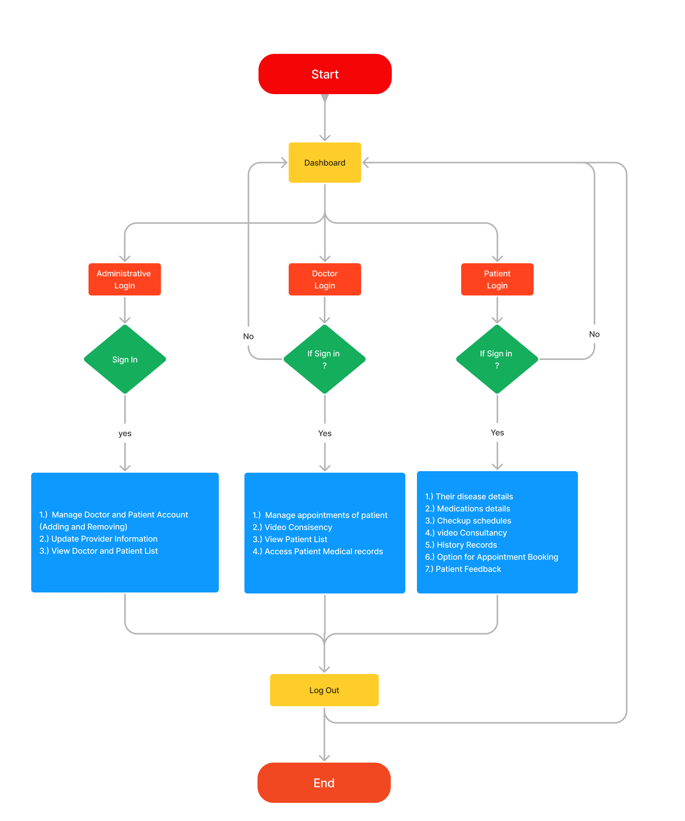
FLOW CHART

Slide 8
SOFTWARE REQUIREMENTS
FRONTEND
BACKEND
DATABASE
HTML5
CSS
JAVA SCRIPT
REACT JS
PYTHON (DJANGO)
MY SQL

Slide 9
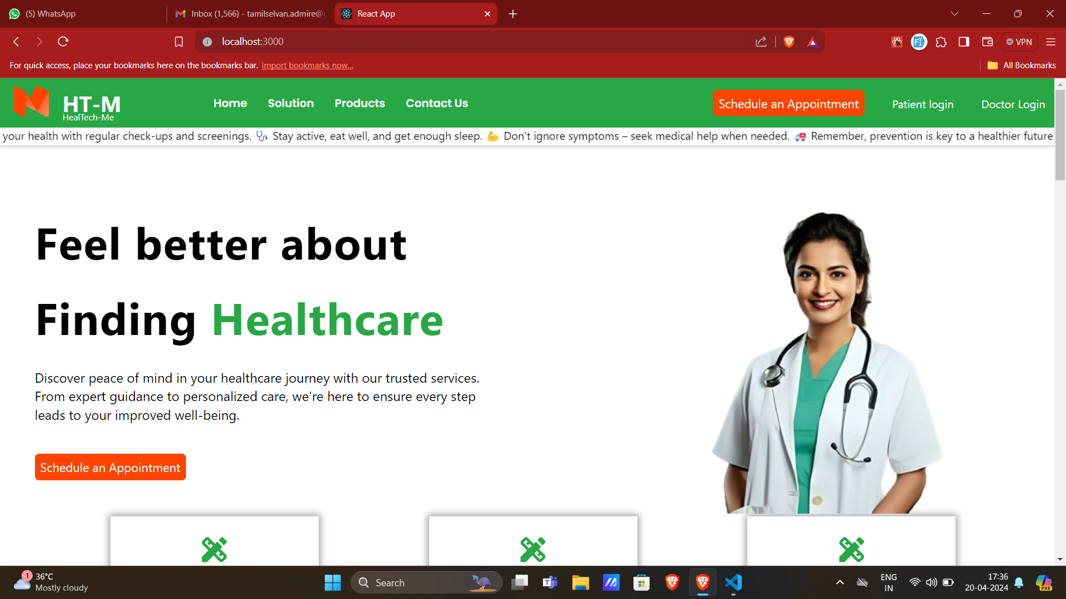
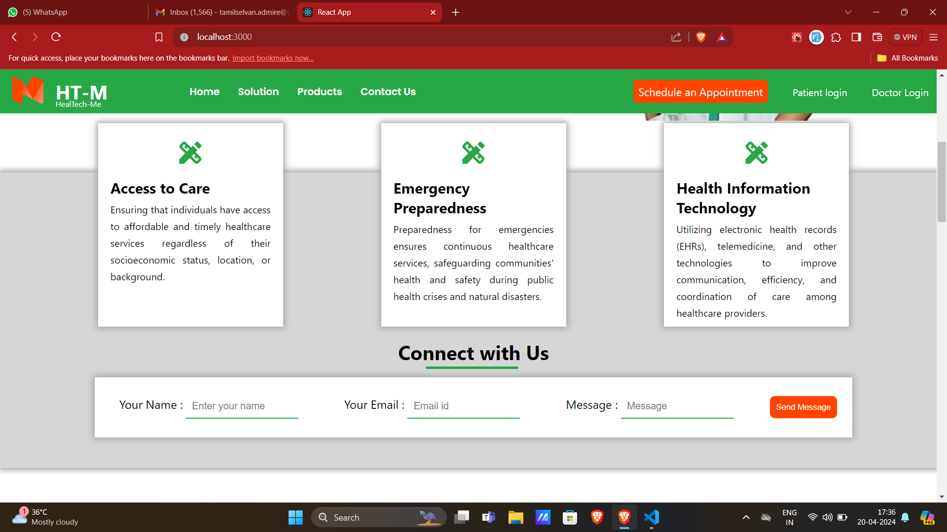
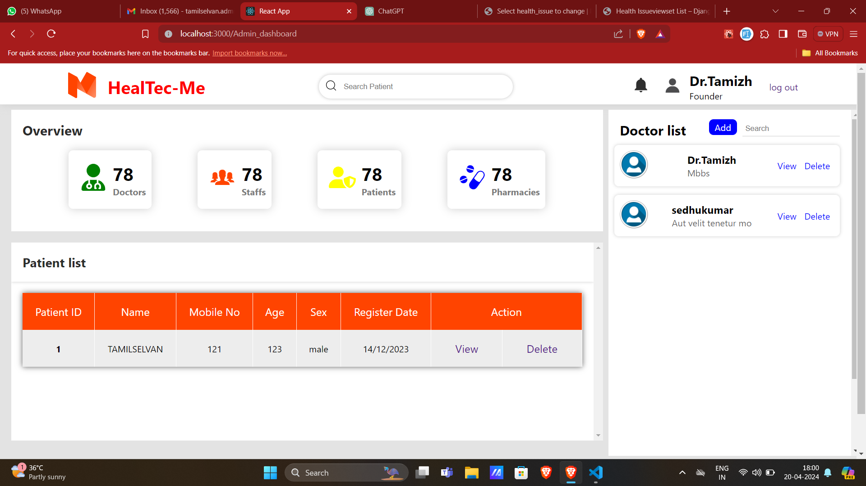
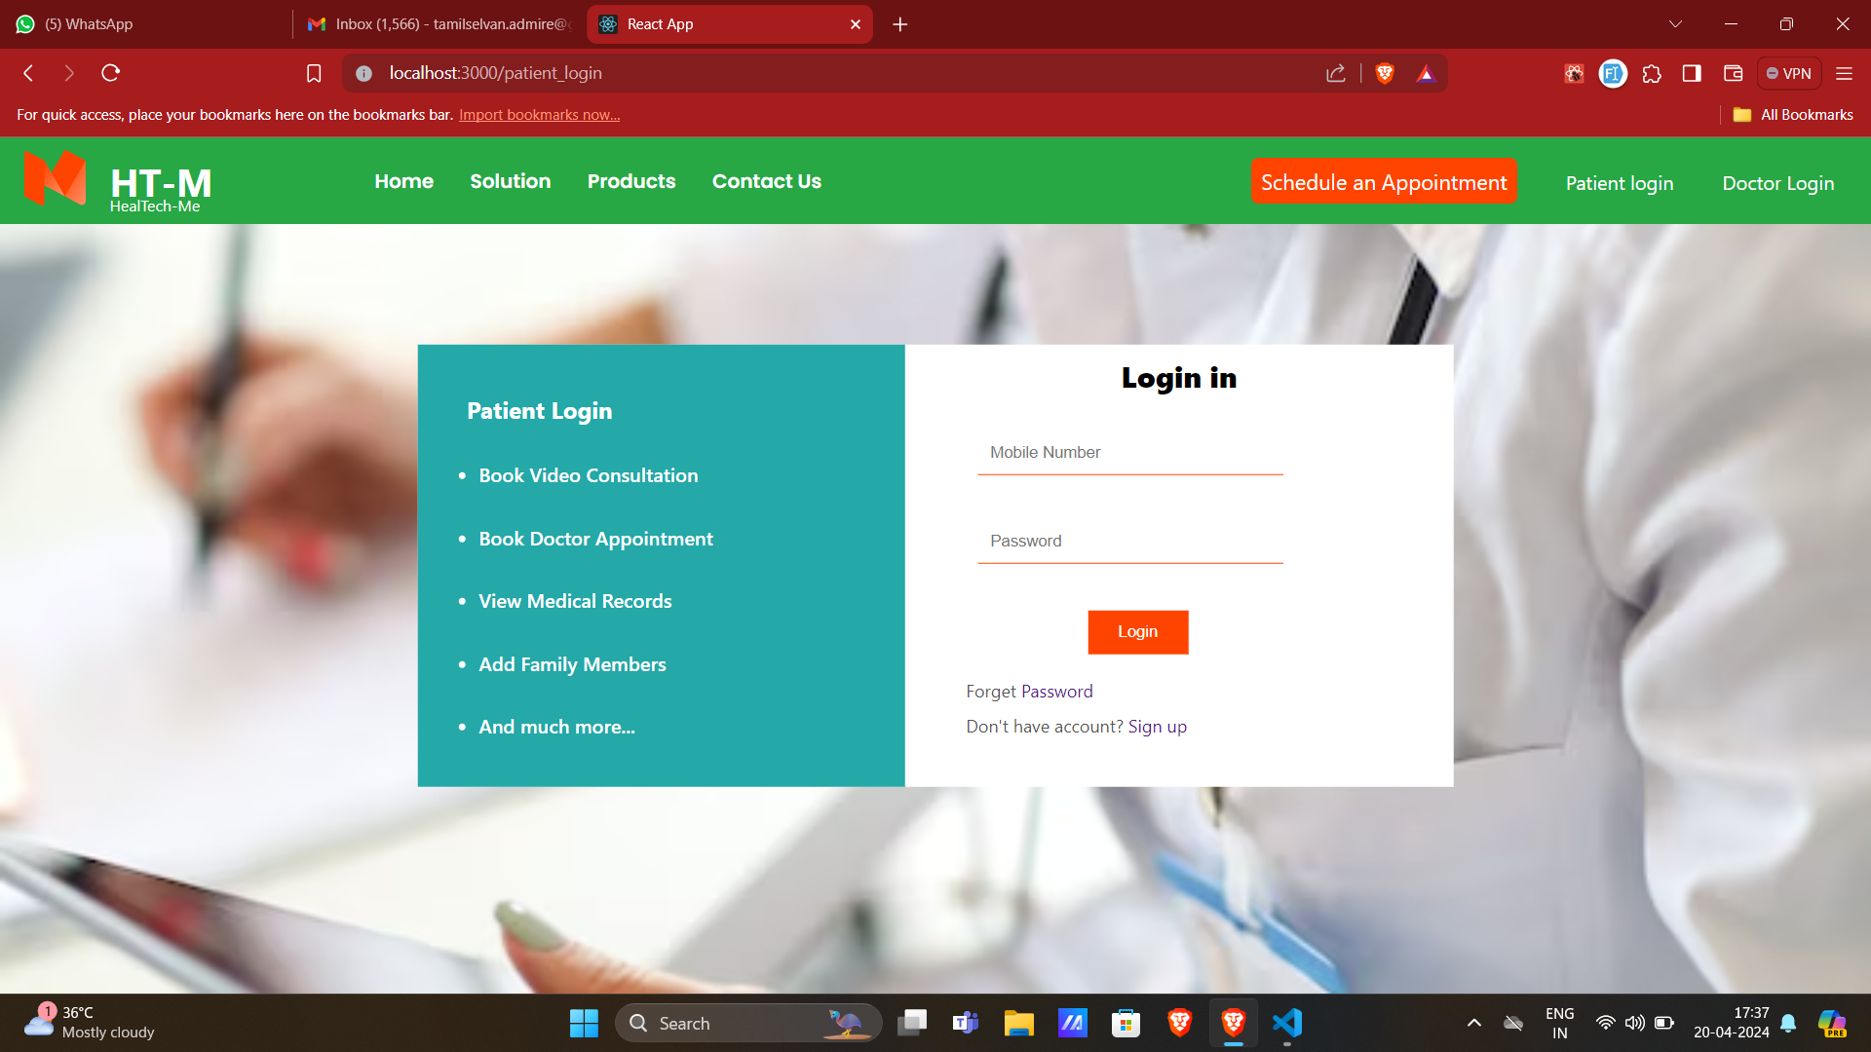
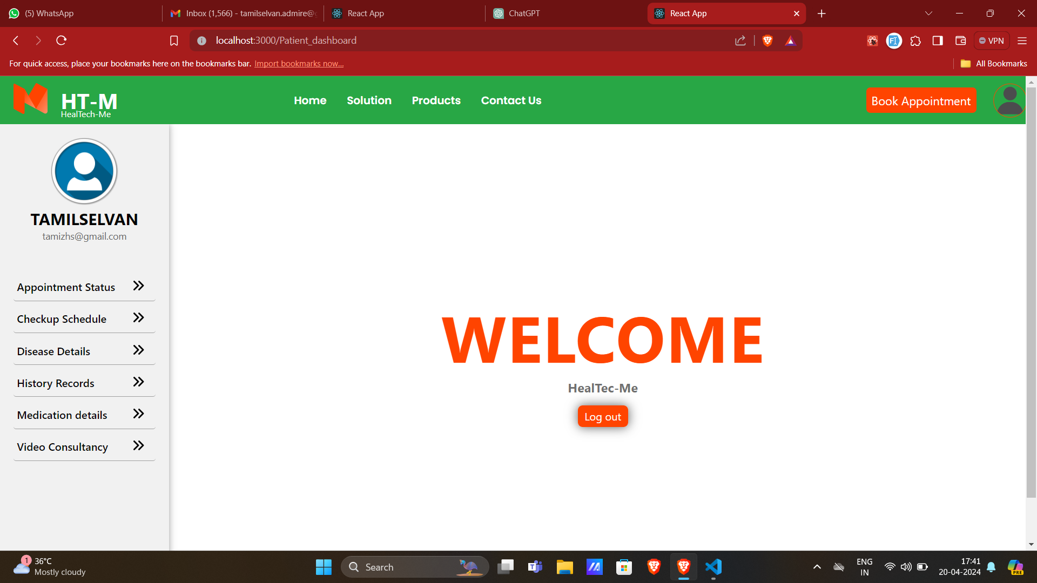
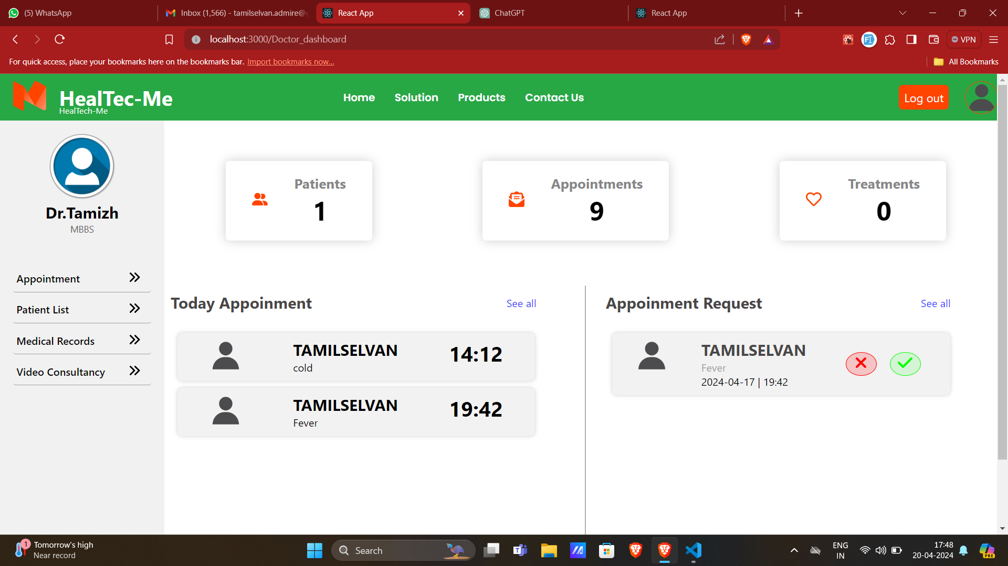
OUTPUT

Slide 10
CONCLUSION
The Healthcare Management System (HMS) represents a significant advancement in healthcare technology, focusing on enhancing patient care outcomes and operational efficiency. With dedicated login panels for administrators, doctors, and patients, the system streamlines communication and collaboration. Administrators benefit from streamlined processes, doctors gain access to comprehensive patient information and remote consultation tools, while patients enjoy enhanced access to services like appointment scheduling and medication management. By optimizing healthcare processes and promoting patient-centered care, the HMS improves patient satisfaction, operational efficiency, and overall healthcare quality.

Slide 11


THANK
YOU

